Slide 1
Managing Permissions and Ownership
Modify File and Directory Permissions
Modify File and Directory Ownership
Configure Special Permissions and Attributes
Troubleshoot Permissions Issues

Slide 2
Permissions
Access rights assigned to users, which enable them to access or modify certain files and directories.
Can be set at different levels and for different access contexts.
Enable you to configure who can and can't access an object.
Controlling access through permissions mitigates risk.
Users only have access to what they need, and no more.

Slide 3
Permission Attributes
Attribute | Description
Read (r) | Files: Access and view contents of a file. Directories: List contents of directory.
Write (w) | Files: Save changes to a file. Directories: Create, rename, delete files in directory (requires execute).
Execute (x) | Files: Run a software file. Directories: Access directory, execute file from directory, perform task on directory.

Slide 4
Permission Contexts
Permission attributes apply to one of several contexts.
The types of users/entities to give permission to.
Contexts:
Owner (u)
Also called user.
Group (g)
Members of object's group.
Other (o)
All other users.

Slide 5
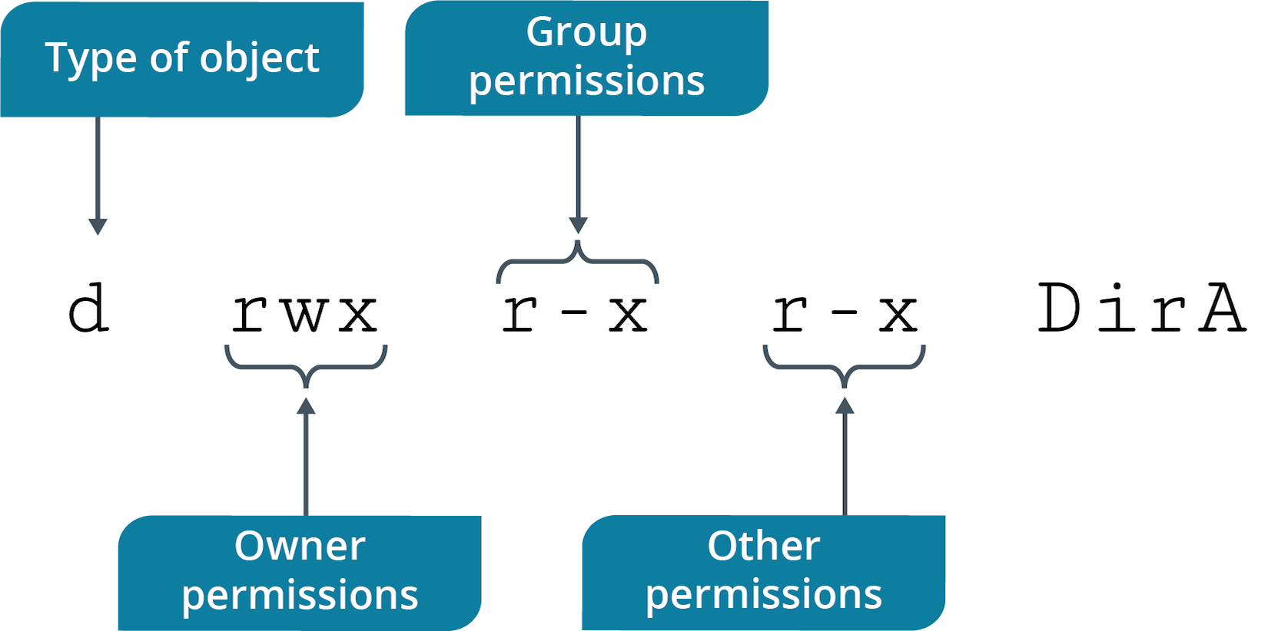
Permission String

Slide 6
The chmod Command
Enables you to modify permissions on files/directories.
Can only be done by owner of object or sysadmin.

Slide 7
chmod Command Options
Option | Used To
-c | Report changes made to permissions.
-f | Hide most error messages.
-v | Display diagnostic entry for every object processed.
-R | Modify permissions recursively.

Slide 8
chmod Symbolic Mode (Slide 1 of 2)
Set permissions using three components:
Contexts
Operators
Attributes
Operators:
+ grants permissions.
- denies permissions.
= assigns permissions exactly as provided.

Slide 9
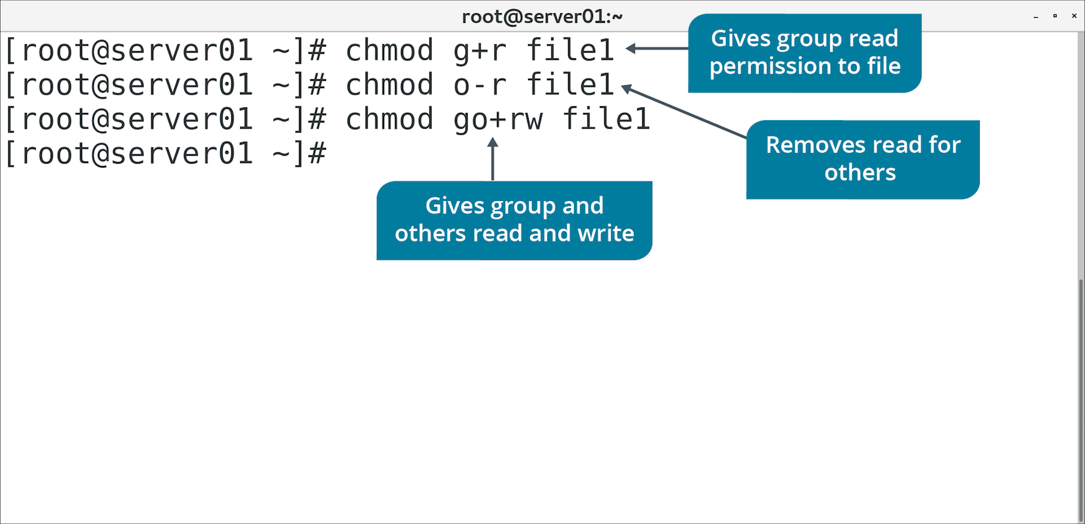
chmod Symbolic Mode (Slide 2 of 2)

Slide 10
chmod Absolute Mode (Slide 1 of 2)
Uses octal numbers.
4 = read
2 = write
1 = execute
Add numbers of permissions you wish to grant.
Sum of these is what you provide.
Read, write, execute is 7 (4 + 2 + 1).
Read, write is 6 (4 + 2).
Complete permissions are expressed as three-digit number.
Each digit corresponds to a context (owner, group, other).

Slide 11
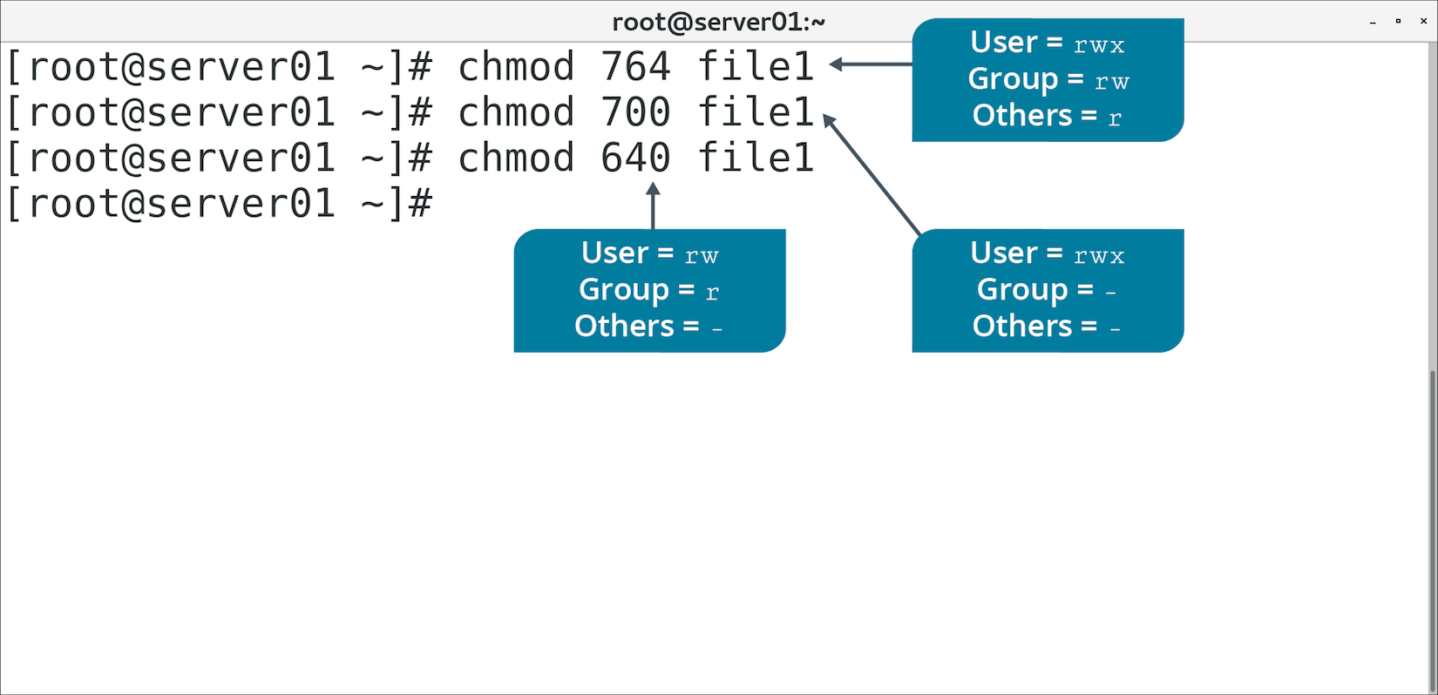
chmod Absolute Mode (Slide 2 of 2)

Slide 12
Activity: Modifying File and Directory Permissions
You're concerned about protecting files on a Linux server.
You'll configure permissions for file owner, group, and other users.

Slide 13
Default Permissions
Assigned to newly created files and directories based on user privileges.
Files created by root user are 644 (rw-r--r--).
Directories created by root user are 755 (rwxr-xr-x).
Files created by regular users are 664 (rw-rw-r--).
Directories created by regular users are 775 (rwxrwxr-x).
Default permissions determined by umask.

Slide 14
The umask Command (Slide 1 of 2)
Alters default permissions on newly created files/folders.
Can be useful for automating custom permissions for new objects.
You set default permissions using octal numeric format.
Specify permissions to mask, not to grant.
Default permissions for non-executable files are 0666
You want owner to retain permissions, but group and others to only have read.
The umask will be 0022
Each number explained:
0 means no advanced permissions set by default.
0 retains current owner permissions (no mask).
2 masks the default of 6, leaving 4 (read only) for the group.
2 does the same, but for others.
Can be set for session or per-user (in .bashrc).

Slide 15
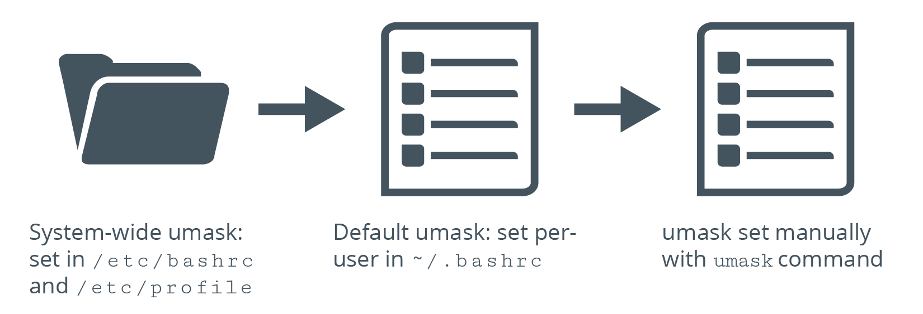
The umask Command (Slide 2 of 2)

Slide 16
Discussing File and Directory Permissions

Slide 17
Activity: Modifying Default Permissions
Chris Mason wants to create files with non-default permissions.
Will be able to share them more easily with co-worker.
You'll implement the change for Chris.

Slide 18
Ownership
The property by which a user can apply and modify the permissions of a file or directory.
First permission context is owner.
By default, owner is the user who created the object.
No other user can modify permissions (except root).
Owner usually changes r/w/x permissions.
Owner can also change advanced/special permissions.

Slide 19
The chown Command
Changes owner, group, or both for a file or directory.
You may want other users besides the creator to manage permissions of an object.
chown {user name} {file/directory name}
Change owner.
chown {user name}:{group name} {file/directory name}
Change owner and group.
chown {user name}: {file/directory name}
Change owner, and change group to specified user's login group.
chown :{group name} {file/directory name}
Change group.

Slide 20
The chgrp Command
Changes group ownership of a file or directory.
Useful for applying permissions to a group.

Slide 21
Discussing File and Directory Ownership

Slide 22
Activity: Modifying File and Directory Ownership
You'll create a Graphics department directory.
Members can store content here.
You'll configure ownership and group associations for directory and files.

Slide 23
Special Permissions
Used when normal permissions are inadequate.
Less privileged users execute file by assuming privileges of file's owner/group.
Enables user to assume high-level privileges in a limited context.

Slide 24
SUID and SGID Permissions
SUID/SGID: The permissions that allow a user to assume the file owner's/group's privileges.
SUID: Certain executables require access to additional resources.
User may not have explicit permission to these.
The passwd command is configured so users will execute it as root (owner).
Gives user permission to access additional resources.
SGID can also be set on directories.
Subdirectories inherit SGID permission.
New files/subdirectories inherit directory's group ID, not group ID of creator.
Inheritance is useful in shared environments.
Users don't need to change groups when creating objects.
SGID doesn't apply to existing or moved objects.
Use chmod to set either SUID or SGID.
Look for s permission when using ls –al command.

Slide 25
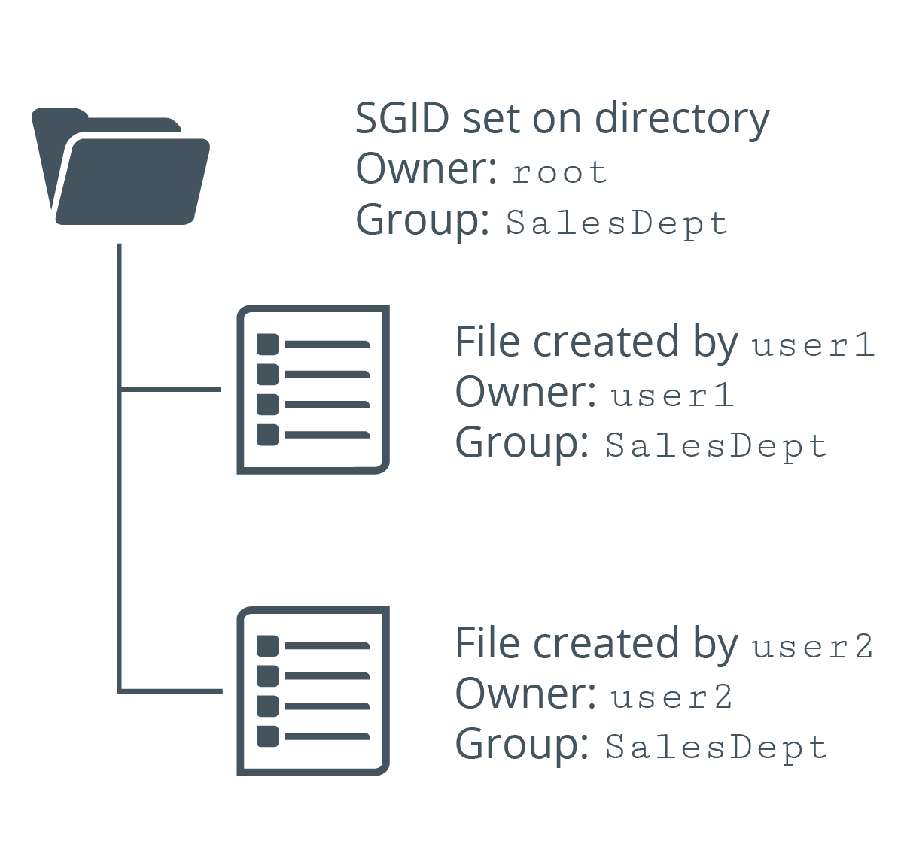
Example of SGID

Slide 26
Sticky Bit
A special permission bit that provides protection for files in a directory.
Only owner or root can delete the object.
Otherwise, users with write/execute permissions can delete the object.
Ensures users can't delete, but can still write/execute.
Set with chmod command.
Indicated by t or T in other execute position when using ls -al

Slide 27
File Attributes
Further determine how system interacts with files.
Go beyond typical permissions.
More granular control over what system is/is not allowed to do.
There are many attributes.
Examples:
Only allow file to be opened in append mode.
Automatically compress file.
Save file if it is deleted.
Make file immutable.

Slide 28
The Immutable Flag
An attribute of a file or directory that prevents it from being modified, even by the root user.
No one can rename, delete, or write to the file.
Useful for sensitive, critical files that don't change much.
Careless user or errant process can't modify the file.
Flag not set on all files.
One directory can have a mix of mutable/immutable files.
Immutable subdirectory can have mutable files.
Lowercase i indicates flag is set.

Slide 29
The lsattr Command (Slide 1 of 2)
Used to list attributes of files/directories.
Option | Used To
-R | Recursively list attributes of directories and their contents.
-a | List all files in directories.
-d | List directories like files, instead of their contents.
-v | List version number of files.

Slide 30
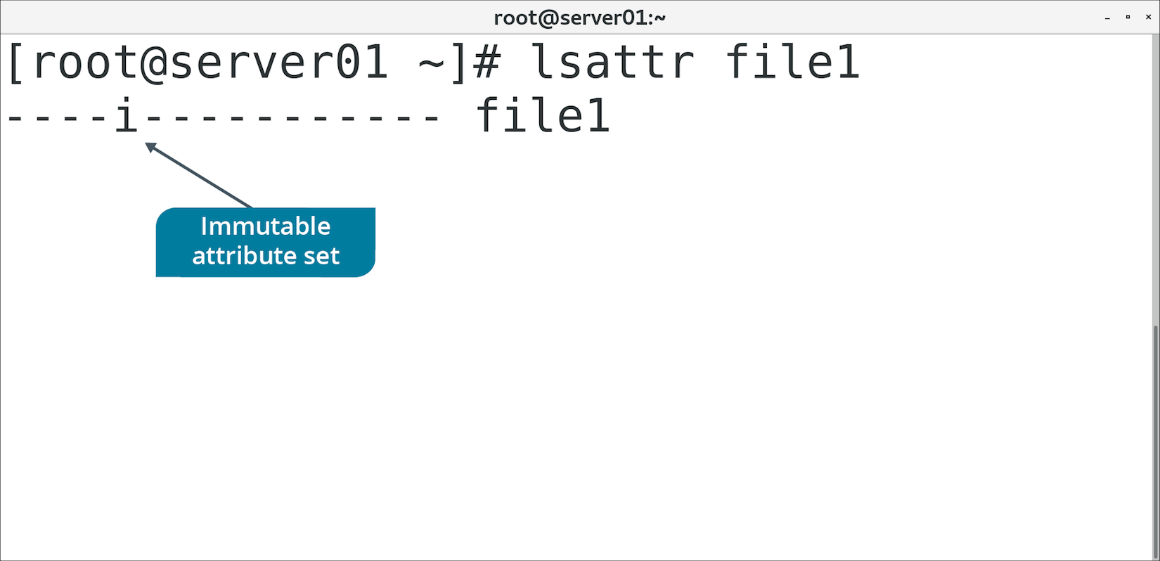
The lsattr Command (Slide 2 of 2)

Slide 31
The chattr Command
Used to change file/directory attributes.
Option | Used To
-R | Recursively change attributes of directories and their contents.
-v {version} | Set version number of file.
+i | Mark file as immutable.
-i | Remove immutable attribute.

Slide 32
Access Control Lists
A list of permissions attached to an object.
Can be used when traditional permissions don't suffice.
Enable you to assign permissions to individual users and groups.
Even when user/groups don't correspond to object's owner/group.
Example: Group 1 needs r/w/x to a directory and Group 2 needs r/x
You can get more granular with controlling access.

Slide 33
The getfacl Command (Slide 1 of 2)
Used to retrieve ACLs of files and directories.
Output shows metadata about file and permissions info.

Slide 34
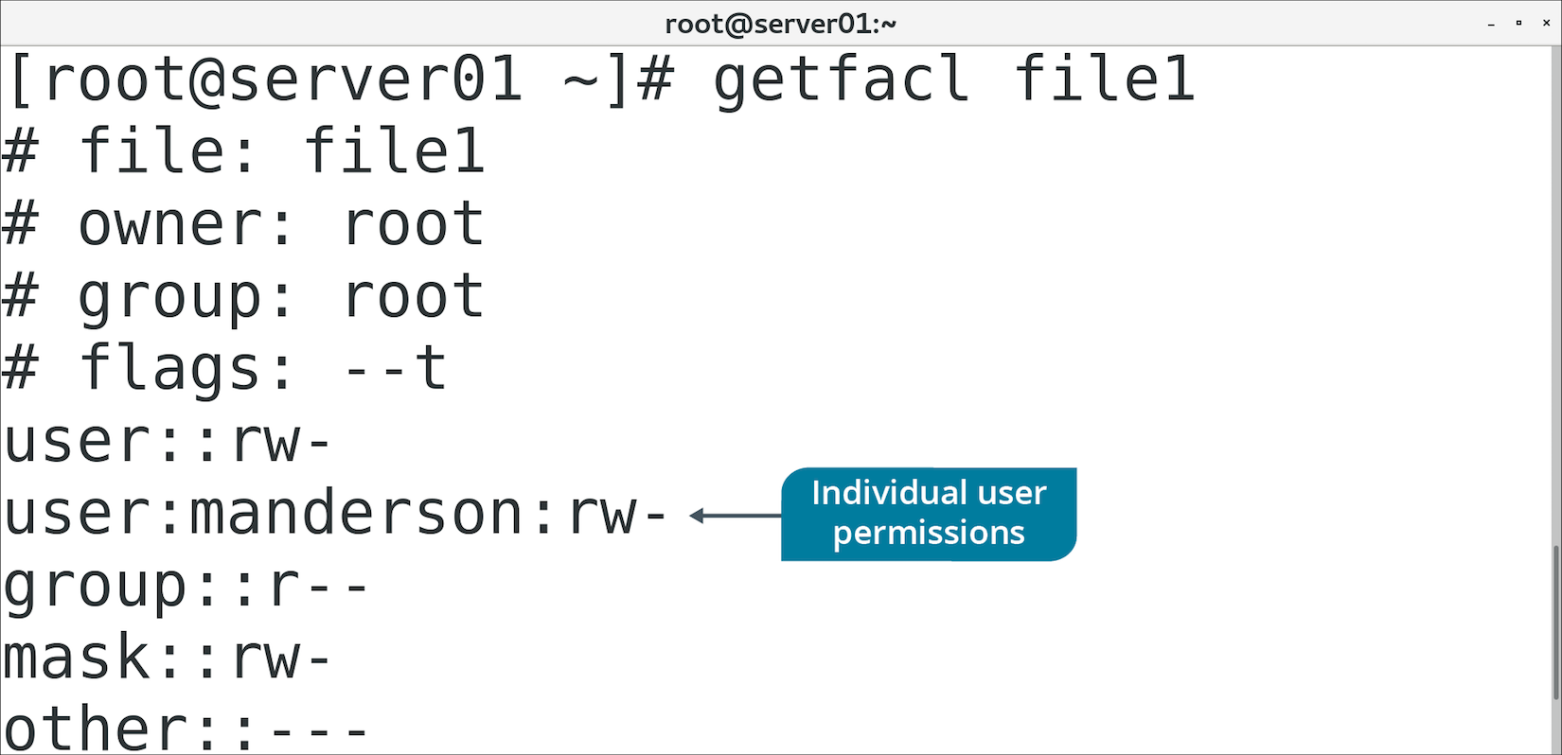
The getfacl Command (Slide 2 of 2)

Slide 35
The setfacl Command
Used to change permissions associated with file/directory ACLs.
Option | Used To
-R | Recursively set ACL options for directories and their contents.
-s | Set ACL of an object/replace existing ACL.
-m | Modify existing ACL.
-x | Remove entries from existing ACL.
-b | Remove all ACL entries.

Slide 36
Discussing Special Permissions and Attributes

Slide 37
Activity: Configuring SGID Permissions and Sticky Bits
Group associations for /Graphics aren't applied to files created there.
A user complained about another user accidentally deleting files.
You'll correct these issues.

Slide 38
Activity: Setting the Immutable Flag on a File
You have a README in /Graphics to guide new users.
You want to ensure no one can delete this file.
You'll set the immutable attribute on the file.

Slide 39
Activity: Configuring ACLs
Marketing department needs read-only access to /Graphics
Standard permissions only define one group association.
You'll use ACLs to ensure both departments have access.

Slide 40
Troubleshooting
The recognition, diagnosis, and resolution of problems.
Begins with identifying the problem.
Doesn't end until services are restored and problem no longer affects users.
Can take many forms.
All approaches have same goal:
Solve problem efficiently with minimal disruption.

Slide 41
Troubleshooting Models
Step-by-step approaches to troubleshooting.
Many models that vary in approach.
All models support a methodical and repeatable pattern of troubleshooting.
Example model:
Identify the problem.
Establish a theory of probable cause.
Test the theory to determine the cause.
Establish a plan of action to resolve the issue.
Implement a solution or escalate the issue.
Verify system functionality and implement preventative measures.
Document findings, actions, and outcomes.

Slide 42
Permissions Troubleshooting (Slide 1 of 2)
Always verify permissions with ls -al first.
Symptom | Cause and Solution
Owner of file can't view its contents. | Cause: User is not granted read access. Solution: Use chmod to grant read privileges to owner.
User can't remove directory despite having write permission. | Cause: User needs write and execute permission to modify directory. Solution: Use chmod to add execute permission to directory.
User can't enter directory despite having read access. | Cause: User needs execute permission to enter directory. Solution: Use chmod to add execute permission to directory.
User can't remove file, but has full permissions on it. | Cause: User needs write permission on containing directory. Solution: Use chmod to add write permission to directory.
User can't create files in a directory they have write/execute permission to. | Cause: Immutable flag is set on directory. Solution: As root, remove immutable flag using chattr command.

Slide 43
Permissions Troubleshooting (Slide 2 of 2)
Symptom | Cause and Solution
Root user can't modify a file. | Cause: Immutable flag is set on file. Solution: As root, remove immutable flag using chattr command.
All users can list directory contents, but only owner/group/service account should. | Cause: Read permission is set on directory for others context. Solution: Remove read permission for others context. Add service account to directory's ACL with read access.
User denied permission to execute a script they themselves created. | Cause: Execute permission is not automatically set on new files. Solution: Use chmod to add execute permission to script.
User denied permission to change a script they can execute | Cause: User needs write permission to script. Solution: Use chmod to add write permission to script.
User denied permission to execute script they have execute permission to. | Cause: User also needs read permission to script. Solution: Use chmod to add read permission to script.
All users can delete file, but should only be able to write to it. | Cause: Write/execute permissions on directories enable users to delete objects. Solution: Add sticky bit to directory.

Slide 44
Ownership Troubleshooting
Always verify ownership with ls -al first.
Symptom | Cause and Solution
User can't access file, but owner context has full permissions. | Cause: User is not owner of file. Solution: Use chown to make user owner of file.
User can't delete file, but containing directory gives full permissions to group. | Cause: Directory's group is not the same as user's group. Solution: Use chgrp to make directory's group the same as the user's.
Users can modify a file, but others context only has read permission. | Cause: File's group is set to same group that users are members of. Solution: Use chgrp to change file's group to a different group.
User creates file in shared directory, file takes on user's group ID when it should take on directory's group ID. | Cause: Files take on creating user's group ID by default. Solution: Use chmod to set SGID permission inheritance.
User creates file in shared directory, file takes on directory's group ID when it should take on user's group ID. | Cause: SGID permission is set on directory Solution: Use chmod to remove SGID permission on directory.

Slide 45
Group Membership Troubleshooting
Issues can arise if users are not in the right groups.
Use groups {user name} to check what groups a user is a member of.
Default owning group of new files may be unexpected.
Make sure expected group is user's primary group.
Use usermod to change group membership.
Consider listing all members of a group.
Not one command universal to all Linux distros.
/etc/group leaves out primary group members and other authentication.
lid and getent can provide more complete info.

Slide 46
Guidelines for Troubleshooting Permissions Issues
Follow an overall troubleshooting strategy.
Follow a step-by-step troubleshooting model.
Start by verifying an object's permissions and ownership using ls -al command.
Ensure users have permissions to work with file.
Ensure users don't have permissions beyond what they need.
Ensure objects don't have the immutable flag if they need to be modified.
Set SUID permission on an executable to run it with root permissions.
Set sticky bit when only the owner/root should be able to delete object.
Ensure objects have proper owner and group set.
Set SGID permission on directory for new files to inherit its group ID.
Use groups {user name} to verify the groups a user is a member of.
Modify group membership when necessary.
Acquire and use tools like lid and getent to view all members of a group.

Slide 47
Activity: Troubleshooting Permissions Issues
You're servicing requests at the help desk.
You need to identify permissions issues and suggest resolutions.

Slide 48
In what situations might you want to change the default permissions on your Linux systems?
Do you prefer to set permissions using symbolic mode or absolute mode, and why?

